Slide 1
CS 2212
Introduction to Software Engineering
Chapter 6 & 7 Principles that Guide Practice and Introduction to Requirements Modeling

Slide 2
Copyright Notice This Presentation and Its Associated Video Contain Copyright Material. This Presentation and Its Associated Video Are Provided for Teaching Purposes of CS2212 and Should Not Be Posted In Any External Site, Or Shared with. This Presentation and Its Associated Video Are Provided For Instructional Personal Use Only, and Only For The Purposes of the CS2212 Course.

Slide 3
Part 15
Guiding Principles and Intro to Requirements Modeling
FAST. GOOD. CHEAP. Choose any two.
- Common Project Scheduling Mantra
Notes:
This lesson introduces the basic steps in a software engineering project at a high level.
In practice, steps often overlap.

Slide 4
Learning Objectives in this Part
To learn what is the role of requirements engineering and requirements modeling
To learn the concept of requirements elicitation and modeling process
To understand the concepts of requirements verification and requirements validation
To get a brief introduction of the different types of models which need to be drafted for the specification of system requirements

Slide 5
Modeling Principles
In software engineering work, two classes of models can be created:
Requirements models (also called analysis models) represent the customer requirements by depicting the software in three different domains: the information domain, the functional domain, and the behavioral domain.
Design models represent characteristics of the software that help practitioners to construct it effectively: the architecture, the user interface, and component-level detail.

Slide 6
Requirements Engineering
Idea of a new
product
(to solve some
problem in the
real world)
Requirements
Elicitation and
Modelling
(the process of
creating the
requirements
spec)
Requirements
Specification Document
(the document that
describes what
has to be built,
not how)

Slide 7
Requirements Engineering Process
Problem
Statement
Problem
Statement
Generation
Requirements
Elicitation
system
specification:
Model
Requirements
Analysis Process
analysis
(Activity Diagram)
model: Model

Slide 8
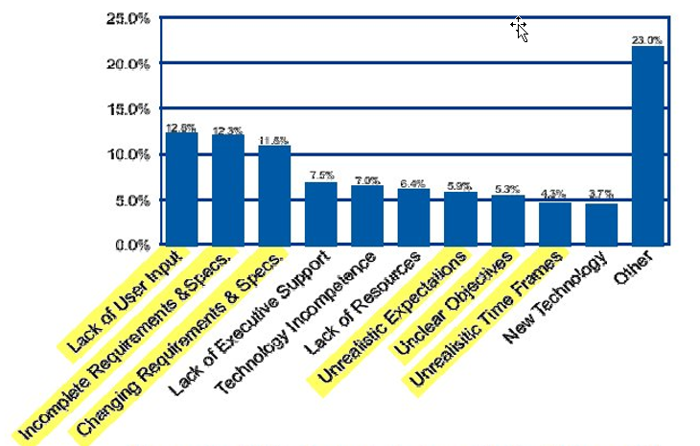
Why Do Software Projects Fail?
352 Companies – 8,000 projects. The Standish Group

Slide 9
Types of Requirements
Three basic types of requirements:
Functional requirements:
What the system is supposed to do – Its functionality
These requirements define the reasons a system should be built
Non-functional requirements:
What are the characteristics of the system – Quality characteristics, properties etc.
These requirements define the properties which we will examine to evaluate whetyer the system is successful or not
Constraints:
Requirements that have a global scope on the system and impose specific characteristics
In a nutshell requirements exist either because either
The type of the product requires them or
The user wants them

Slide 10
Requirements Modeling Principles
Principle #1. The information domain of a problem (the data that flows in, flows out, or stored) must be represented and understood.
Principle #2. The functions that the software performs must be defined.
Principle #3. The behavior of the software (as a consequence of external events) must be represented.
Principle #4. Models must be partitioned in a manner that uncovers detail in a layered (or hierarchical) fashion.
Principle #5. The analysis task should transition gradually from essential requirements related information towards design and implementation detail.

Slide 11
Characteristics of Software Requirements
Clarity: The meaning and the significance of the requirement has to be clearly defined
Consistency: One requirement can not be inconsistent with another (it can be conflicting though)
Completeness: All requirements are fully defined (relates also with clarity)
Verifiable: The requirements can be verified against the final implementation
Independence of technological and implementation factors: The requirement specification has to be independent of any preoccupations we may have towards specific design decisions we may favor or want to follow:
Requirement → What the system is supposed to do
Implementation → How the system satisfies its requirements

Slide 12
Requirements Analysis
A requirements analysis:
Specifies the software’s operational characteristics
Indicates the software's interface with other system elements
Establishes constraints that the software must meet
Requirements analysis allows a software engineer to:
Elaborate on basic requirements established during earlier requirement engineering tasks
Build models that depict user scenarios, functional activities, problem classes and their relationships, system and class behavior, and the flow of data as it is transformed

Slide 13
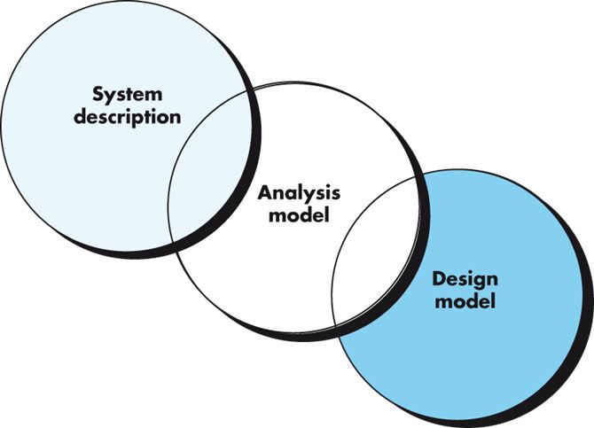
Requirements/Analysis Models as a Bridge

Slide 14
Negotiating Requirements
Ideally, inception, elicitation, and elaboration tasks determine requirements cleanly and in sufficient detail to move forward
This rarely happens in reality, and some form of negotiation is necessary
In negotiation, stakeholders are asked to balance functionality, performance, and other product or system characteristics against cost and time-to-market needs
The intent of negotiation is to develop a project plan that meets stakeholder needs while at the same time reflecting the real world constraints on the project

Slide 15
Communication Principles
Principle #1. Listen. Try to focus on the speaker’s words, rather than formulating your response to those words.
Principle # 2. Prepare before you communicate. Spend the time to understand the problem before you meet with others.
Principle # 3. Someone should facilitate the activity. Every communication meeting should have a leader (a facilitator) to keep the conversation moving in a productive direction; to mediate any conflict that does occur; and to ensure than other principles are followed.

Slide 16
Communication Principles
Principle #4. Face-to-face communication is best. But it usually works better when some other representation of the relevant information is present.
Principle # 5. Take notes and document decisions. Someone participating in the communication should serve as a “recorder” and write down all important points and decisions.
Principle # 6. Strive for collaboration. Collaboration and consensus occur when the collective knowledge of members of the team is combined and trust is built among team members.

Slide 17
Communication Principles
Principle # 7. Stay focused, modularize your discussion. The more people involved in any communication, the more likely that discussion will bounce from one topic to the next. Only leave a topic when it has been resolved.
Principle # 8. If something is unclear, draw a picture.
Principle # 9. (a) Once you agree to something, move on; (b) If you can’t agree to something, move on; (c) If a feature or function is unclear and cannot be clarified at the moment, move on.
Principle # 10. Negotiation is not a contest or a game. It works best when both parties win and so some compromise is often necessary.

Slide 18
Requirements Elicitation Process
It is a tedious process that requires organization and consistency. There are different approaches for requirements elicitation.
The key stakeholders in this process are:
The users of the system they know the application domain
Software Engineers they know how to model problems and implement it as a software system
The objective of the requirements elicitation process is to bridge the sematic gap between system users and software engineers. This bridging is achieved by identifying usage scenarios and creating use cases:
Usage Scenario: Specific example of a system function/operation and how associates/affects other systems
Use Case: Defines describes a group (class) of closely associated usage scenarios

Slide 19
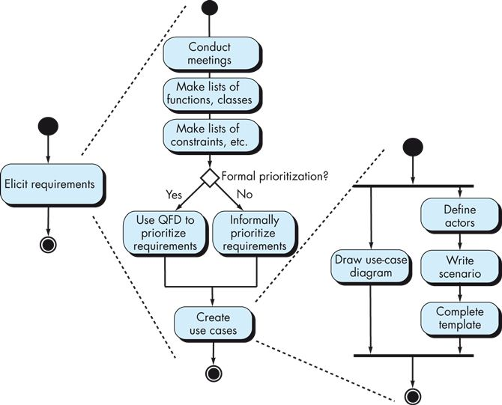
Eliciting Requirements in Summary
QFD is Quality Function Deployment, a quality management technique that emphasizes what is valuable to the customer and how to maximize customer satisfaction

Slide 20
Verification vs. Validation
Verification:
Have the requirements implemented correctly in the code? Verification is achieved with software testing.
Validation:
Have we captured the right requirements? Are we building the right product?

Slide 21
Requirements Validation
The criteria for requirements validation include:
Validation of Correctness: The requirements model is correct and denotes the idea the user/client has
Validation of Completeness: To ensure that all possible uses and scenarios of the system have been captured and modeled, and thee are nor inconsistencies among them
Realism: To ensure that the requirements can be implemented given the available technology and resources
Traceability: To ensure that each implementation part can be traced back to a requirement (i.e. this piece of code or this module implements requirement X)

Slide 22
Requirements Verification
Continuous testing and monitoring are especially needed during incremental development to ensure that requirements are continuously to met:
Testing – Constitutes the primary activity for requirements verification
Code Reviews and Walkthroughs – Important activity for code quality and requirements verification
Distributed debugging – uncovers errors and determines their cause
Run-time logging and monitoring – determines whether software matches its specification (i.e. requirements have been correctly implemented)
Business activity monitoring – evaluates whether a system satisfies business goals
Minor and Major milestone meetings and demos – provides information to stakeholders as the system evolves

Slide 23
Building a Requirements Model
A requirements model is an analysis model
The intent of this model is to provide a description of the required informational, functional, and behavioral domains for the system to be built
This model changes over time as you learn more about the system and as other stakeholders learn more about what they really require

Slide 24
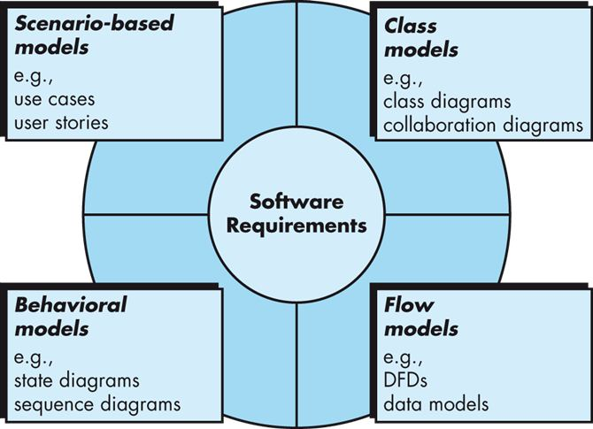
Requirements Models
i.e. The Domain Model
or Communication Diagrams
Data Flow Diagrams
Activity diagrams
E-R Diagrams

Slide 25
Your Turn
Why do we need different types of models (scenario based, class based, behavioral based and flow based) to capture software requirements?
Why the requirements phase is important? After all it is the code we care about, not the models.
Why is it important to validate and verify requirements?
While building a banking system for keeping customer financial records, can you name three different types of stakeholders? Why these may have conflicting requirements? Can you name three conflicting requirements among the stakeholders?
Check-out the content of the following sites:
https://en.wikipedia.org/wiki/Requirements_elicitation
https://en.wikipedia.org/wiki/Requirements_traceability
https://www.geeksforgeeks.org/software-engineering-requirements-validation-techniques/
https://www.geeksforgeeks.org/software-engineering-verification-and-validation/

